Slide 1
Drawing angles
Ms. Latham
Year 7

Slide 2
Learning Intentions
Students will be able to
Practise using the protractor
Draw angles to accuracy of 3 degrees
Read angels with an accuracy of 3 degrees

Slide 3
Review!
Students will be called on to fill in the table so be ready!
Angle Type | Right | Obtuse | Straight | Acute | Reflex | Revolution
Definition
Image
Notes:
Assign a section for each group/pair to discuss with their partners then go up to the board to fill in the blanks. Make sure the WHOLE class agrees before moving on.

Slide 4
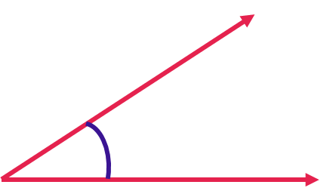
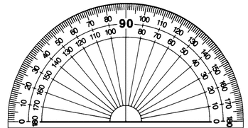
24
7
30
Topic: Drawing Angles
Date:
EQ –How do I draw angles?
How to measure angles?
Step 1: Line up the bottom of the angle with the straight line of the protractor.

Slide 5
24
7
30
Topic: Drawing Angles
Date:
EQ – How do I draw angles?
How to measure angles?
Step 2: Measure from the bottom arm to the top arm of the angle
Make sure the vertex is lined up with the middle of the protractor

Slide 6
24
7
30
Topic: Drawing Angles
Date:
EQ – How do I draw angles?
How to measure angles?
Step 3: Read the protractor = 31°
We are going to do a similar process for drawing angles!

Slide 7
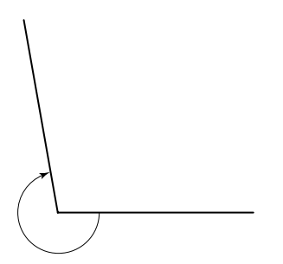
24
7
30
Topic: Type of Angles
Date:
EQ – What are the different types of angles and how do I measure them?
How to measure reflex angles?
Step 1: Measure the inside angle
Inside angle = 100°
Step 2: Reflex angle = 360 – 100
= 260°
Inside acute angle

Slide 8
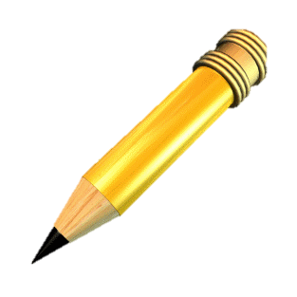
24
7
30
Topic: Drawing Angles
Date:
EQ – How do I draw angles?
How to draw angles?
Step 1: Draw a straight line (you can use a ruler or the bottom of your protractor)

Slide 9
24
7
30
Topic: Drawing Angles
Date:
EQ – How do I draw angles?
How to draw angles?
Step 2: Choose where the vertex will be
A
B

Slide 10
24
7
30
Topic: Drawing Angles
Date:
EQ – How do I draw angles?
How to draw angles?
Step 3: Dot to dot - line up the centre of the protractor with the vertex

Slide 11
24
7
30
Topic: Drawing Angles
Date:
EQ – How do I draw angles?
How to draw angles?
Step 4: Line to line - line up the straight line with the 0°

Slide 12
24
7
30
Topic: Drawing Angles
Date:
EQ – How do I draw angles?
How to draw angles?
Step 5: You read the numbers starting from 0° (where the straight line is) and moving away from 0° until you reach the degree you want and mark with a small dot.
30°

Slide 13
24
7
30
Topic: Drawing Angles
Date:
EQ – How do I draw angles?
How to draw angles?
Step 6: Connect the vertex to the dot
Step 7: Put arrows at the end of the lines
30°

Slide 14

Everyone needs a protractor and a piece of coloured paper.
Send ONE person from each group up to collect the materials.

Slide 15
Guided Practice
Draw these on your left hand side!
Step 1: Draw a straight line
Step 2 : choose where the vertex will be
Step 3: dot to dot
Step 4: line to line
Step 5: Place a dot on the degree
Step 6: Connect the vertex to the dot
Step 7: Put arrows on the end
Notes:
Draw 3-4 angles on the board going through each step.

